Slide 1
Ames Iowa Regression for home prices
Presented by Stephen Strawbridge

Slide 2
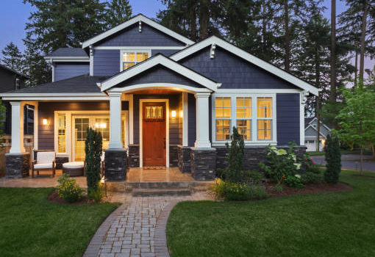
Current problem
Many home flippers do NOT have appraisal skills
> inaccurate price listings
Can data provide insight?
Yes it can! In just a few short steps

Slide 3
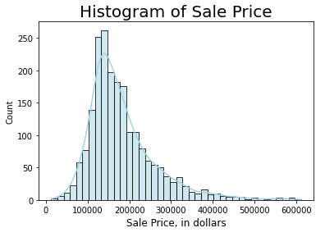
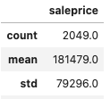
Step 1: explore our data
Summary stats

Slide 4
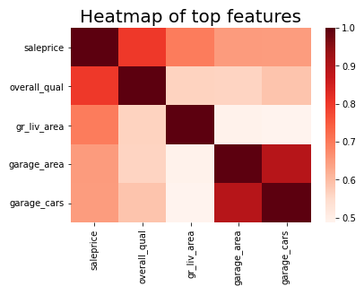
explore our data (cont.) – use heatmaps
Strongest correlations
Overall Quality
Living areas (ground, garage, basement, etc)
Year built

Slide 5
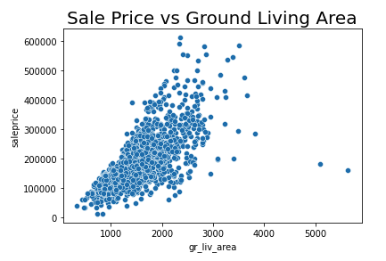
explore our data (cont.) – outliers
Wait!
Is all of our data fairly representable?
We spot 2 outliers

Slide 6
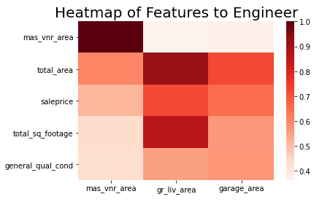
Step 2 – feature engineering
Combine features!
Area of all parts of house (see heatmap on the right)
Total square footage
Number of rooms/bathrooms

Slide 7
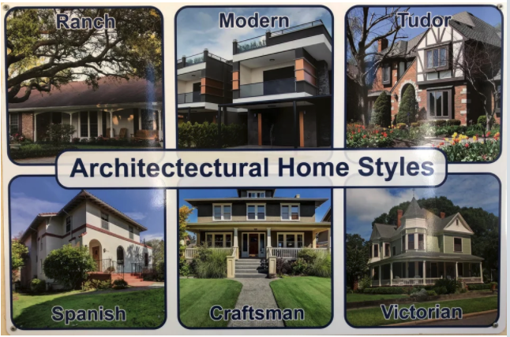
Step 3 – ”Dummify” non-numerical features
Dummify?
Dummify = turn non-numerical features into measurable numerical amounts

Slide 8
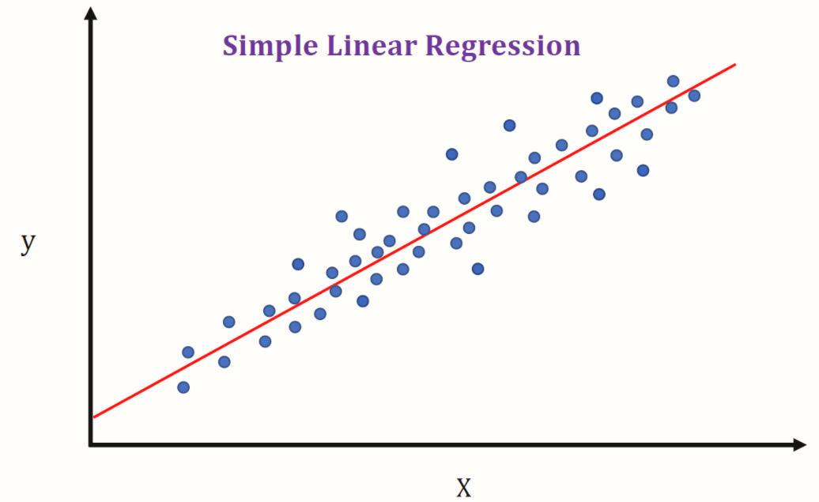
Step 3: modeling on test data
Top features + engineered features + dummy features = final features for model!
Model = linear regression

Slide 9
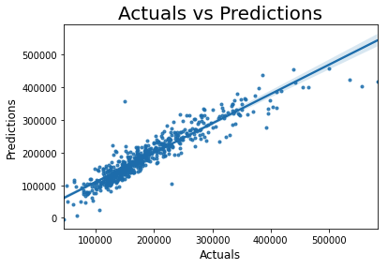
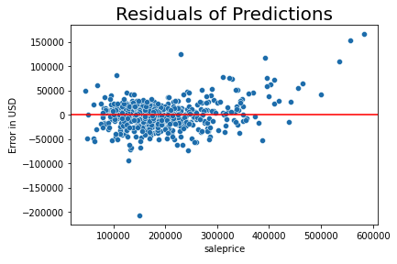
Step 4: results
Residual (Error) = actual price – predicted price
Score = 88%!

Slide 10

Summary and Recommendations
Key takeaway: Statistical modeling can help you arrive at your accurate home price!
Key features of home price:
Total square footage
Overall quality
Age of house
Limitations/recommendations:
Other models can be used

Slide 11
Thank you for your time!
Questions?

Slide 12
Sources
Stock photos: (https://www.istockphoto.com/photos/house?mediatype=photography&phrase=house&sort=mostpopularPrep Scholar Blog)
Reddit architecture images: (https://www.reddit.com/r/coolguides/comments/bhrw0j/architectural_home_styles/)
Medium.com: (https://medium.com/towards-artificial-intelligence/linear-regression-basics-for-absolute-beginners-68ed9ff980ae)

